Slide 1
Using Machine learning models to predict loan default probabilities
Hanwen Miao
Yue Zhou

Slide 2
01
Background
The accurate prediction of loan defaults is crucial for banks and financial institutions. Traditional credit scoring methods rely on the applicant's credit history and financial situation, but these approaches often fail to fully capture potential default risks. Therefore, using machine learning models to predict the probability of loan defaults can provide a more accurate perspective.

Slide 3
02
Steps
1.Preprocess the provided loan dataset
2.Descriptive statistical analysis, exploratory data analysis (EDA), visualization
3.Apply three different machine learning models (decision tree, K-nearest neighbors, random forest) for predicting loan default.
4.Assess the performance of these models

Slide 4
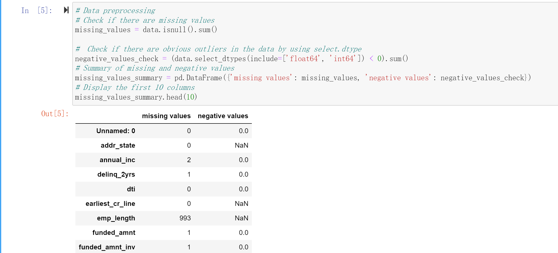
Process the data
Due to the csv file not supporting UTF-8 decoding, we attempted to use Latinl encoding to read the file. Firstly, we adjusted the data by handling some missing values because some modules, such as sklearn.tree, do not support missing values.
01
1.Preprocess the provided loan dataset
handling missing values, outliers

Slide 5
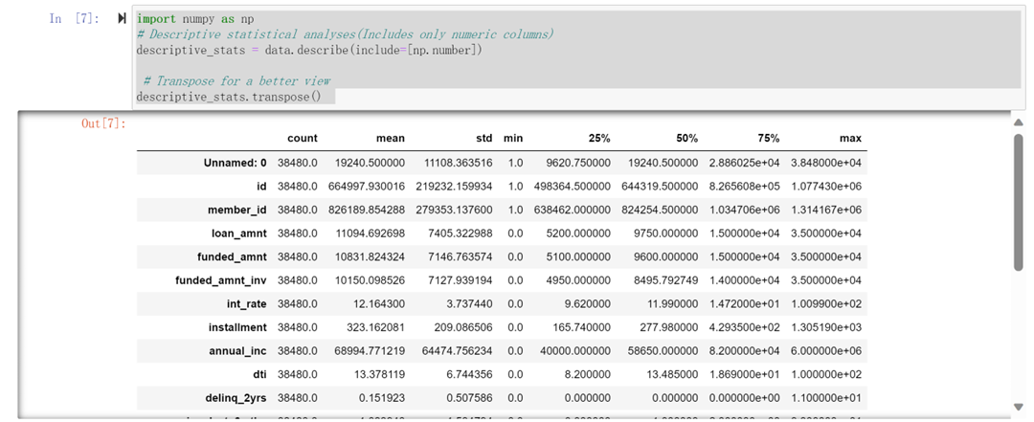
Descriptive statistical analysis of the data
2
loan_amnt: The average loan amount is approximately $11,094.69, with a median of $9,750.
annual_inc: The average annual income is approximately $68,994.77, with a median of $58,650.
int_rate: The average interest rate is approximately 12.16%, with a standard deviation of 3.74%.
dti: The average Debt-to-Income Ratio (DTI) is approximately 13.38, with a standard deviation of 6.74.
total_pymnt: The average total payment amount is approximately $11,980.64."

Slide 6
03
Exploratory Data Analysis

Slide 7
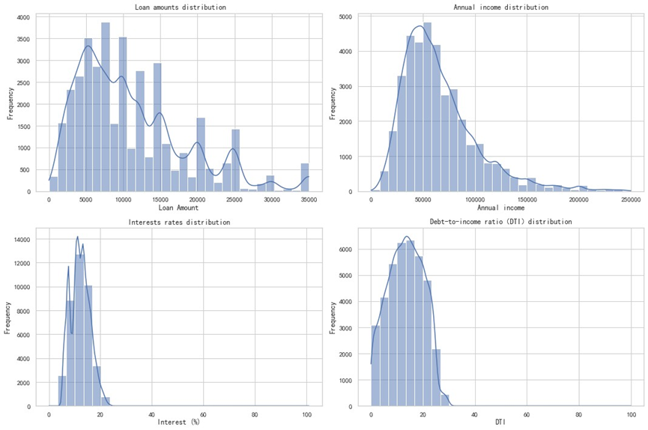
特征工程
Loan Amount Distribution: The majority of loan amounts are concentrated in lower ranges, but there are also some high values.
Income Distribution: Most borrowers have lower annual incomes, and the distribution exhibits a right-skewed pattern. To enhance visualization, we capped the upper limit of annual income at $250,000.
Interest Rate Distribution: The distribution of interest rates is relatively uniform, with a concentration in lower-rate regions.
Debt-to-Income Ratio (DTI) Distribution: The distribution of DTI is relatively uniform, the majority of borrowers have low DTI values.

Slide 8
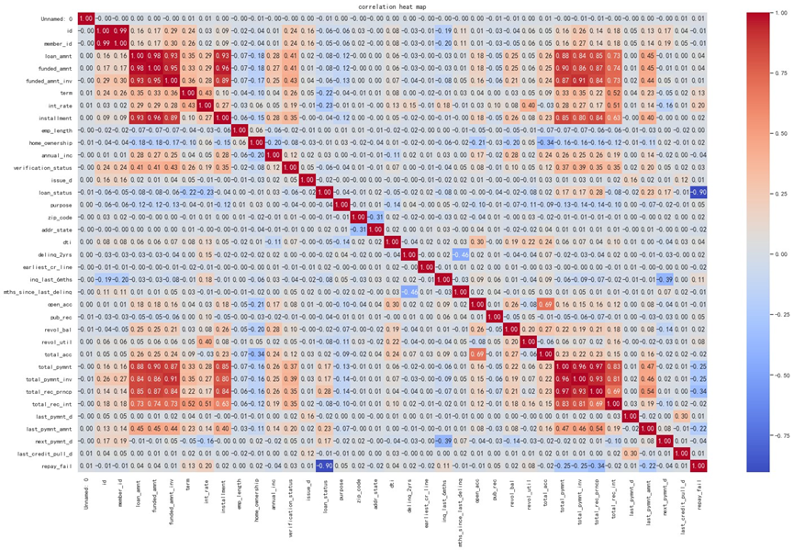
Heat map
The loan amount (loan_amnt), funded amount (funded_amnt), and invested amount (funded_amnt_inv) exhibit a high positive correlation. This suggests that these variables are often interrelated during the loan process.
There is also a notable positive correlation between total payment amount (total_pymnt), total principal received (total_rec_prncp), and the last payment amount (last_pymnt_amnt). These variables reflect the repayment status of the loan.
The interest rate (int_rate) shows relatively lower correlations with other variables, indicating that the interest rate may be influenced by various factors beyond just loan amounts or repayment status.

Slide 9
04
Feature selection

Slide 10

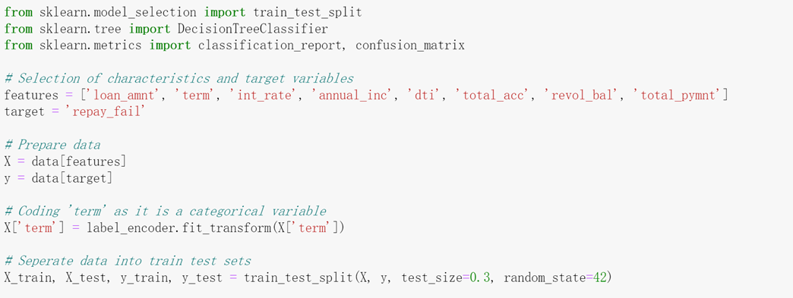
Feaature selection
We selected the following 8 features which may related with loan default
- loan_amnt: Loan amount, which may impact the borrower's repayment capacity.
- term: Loan term, with longer-term loans possibly carrying higher default risks.
- int_rate: Interest rate, higher rates possibly increasing default risks.
- annual_inc: Annual income, income level may influence repayment capacity.
- dti: Debt-to-Income ratio, higher ratios may indicate higher financial pressure.
- total_acc: Total number of accounts, reflecting the borrower's credit history.
- revol_bal: Revolving balance, which may impact the borrower's repayment capacity.
- total_pymnt: Total payment amount to date, reflecting the borrower's repayment record.
We set 30% as the test set.

Slide 11
05
Establish models

Slide 12
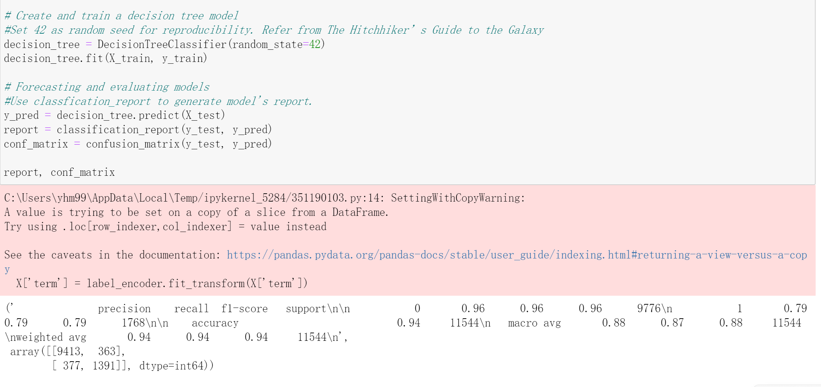
Model I : Decision Tree
Model performance
We use the `classification_report` function to generate the performance report, focusing on the results for the positive class:
- Accuracy : The model achieves an accuracy of 94% on the test set.
- Precision: For cases labeled as defaults, the model correctly predicted 79% of them
- Recall: Among all actual default cases, the model successfully identifies 79%.
- F1 Score: The F1 score, a weighted average of precision and recall, is 0.79 for default cases.

Slide 13
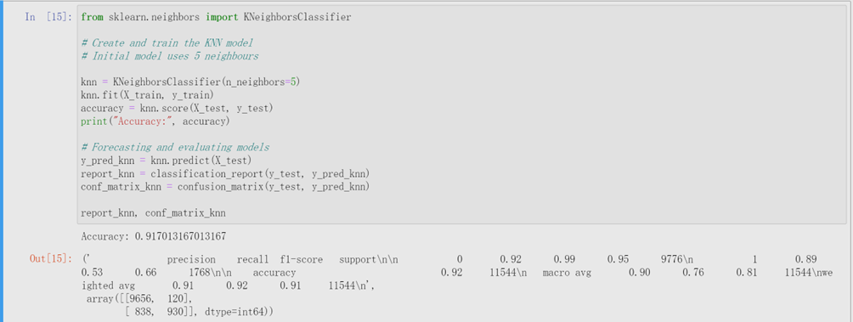
Model II : KNN
Model performance
We set parameter 'n_neighbors' 5, use 5 nearest neighbors for classification, with an odd number helping to avoid decision tie .
The accuracy obtained using the `Knn.score` function is 0.917013167013167.
- Accuracy: The model achieves an accuracy of 92% on the test set.
- Precision: For cases labeled as default, the model correctly predicts 89%.
- Recall: Among all actual default cases, the model successfully identifies 53%.
- F1 Score: The F1 score, is 0.66 for default cases."

Slide 14
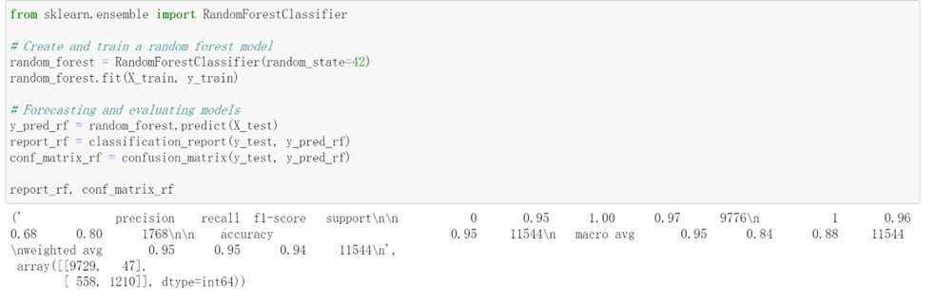
Model III : Random Forest
Model performance
Accuracy: The model achieves an accuracy of 95% on the test set.
Precision: For cases labeled as default, the model correctly predicts 96%.
Recall: Among all actual default cases, the model successfully identifies 68%.
F1 Score: The F1 score, a weighted average of precision and recall, is 0.80 for default cases.

Slide 15
06
Visual comparison of model performance

Slide 16
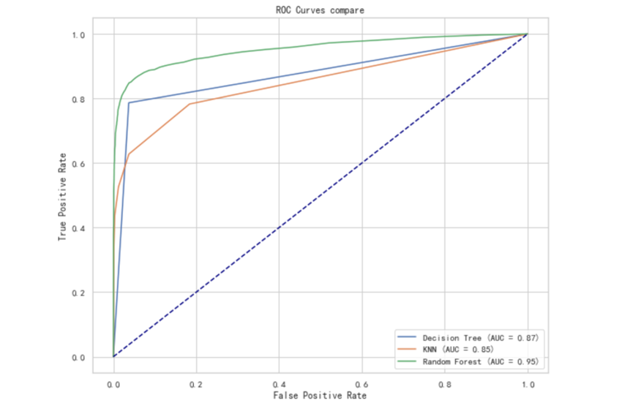
Visual comparison of model performance
Decision tree: AUC ≈ 0.87
KNN: AUC ≈ 0.85
Random Forest: AUC ≈ 0.95
The closer the AUC value to 1, the better the performance of the model.
The Random Forest model has the highest AUC value among three models, indicating the best overall performance. The Decision Tree also performs well, while the KNN performs slightly lower than the other two models.

Slide 17
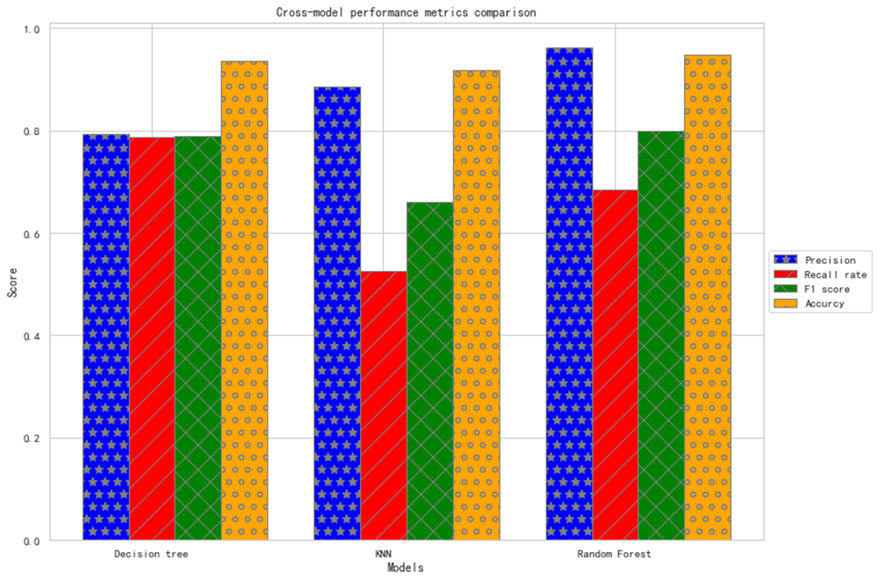
Visual comparison of model performance
According to the four indicators of the different models
Overall. Random Forest is the best, Decision Tree is the 2nd, and KNN is the 3rd, but the overall analysis of the predictive performance of each model on this data has achieved good results

Slide 18
07
Feature importance analysis

Slide 19
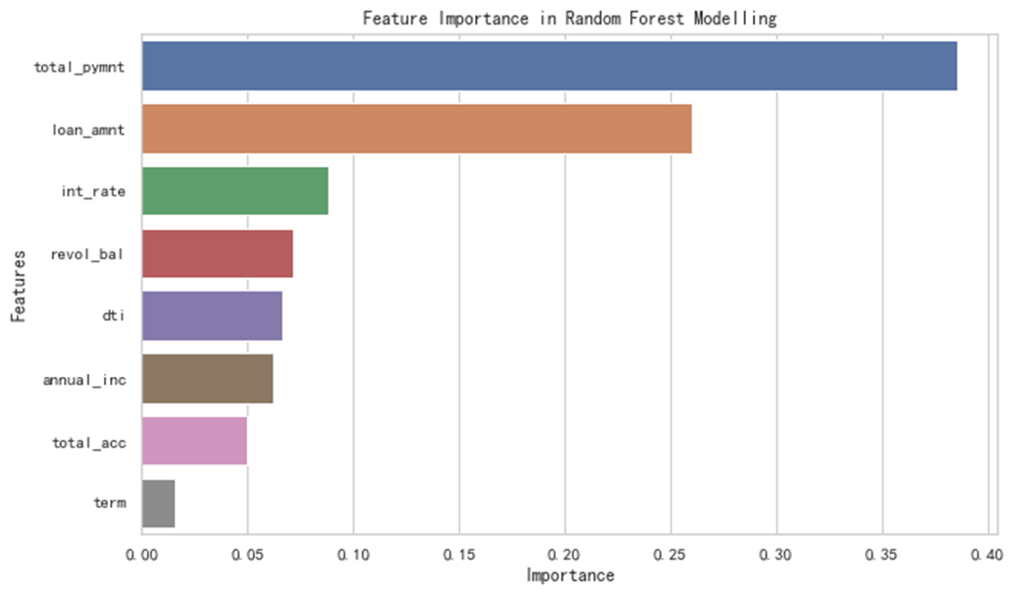
Feature importance Random Forest
According to the results of the random forest model, the features total_pymnt and loan_amnt have the highest importance, which indicates that they play a key role in predicting loan defaults. Other important features include int_rate, dti and revol_bal.

Slide 20
09
Research Summary

Slide 21

Research Summary
In this research, we conducted a comprehensive analysis of a loan dataset with the aim of predicting and understanding the likelihood of loan default. We used three different models: Decision Tree, K Nearest Neighbour, and Random Forest, to predict the risk of loan default. Regarding model building and evaluation, we observed that Random Forest excelled in key metrics such as accuracy, precision, recall, and F1 score. Through the comparison of ROC curves, the Random Forest model exhibited the highest AUC value, indicating its superior capability in predicting loan defaults. Additionally, we analyzed the importance of the model's features and identified which features are most critical for the prediction results.
Overall, we believe there are still many parts in our model that need improvement. And we think that by adopting machine learning models, financial institutions can effectively assess the risk of loan applicants, thereby making more informed lending decisions.

Slide 22
Thank you for watching
Hanwen Miao
Yue Zhou

